Slide 1
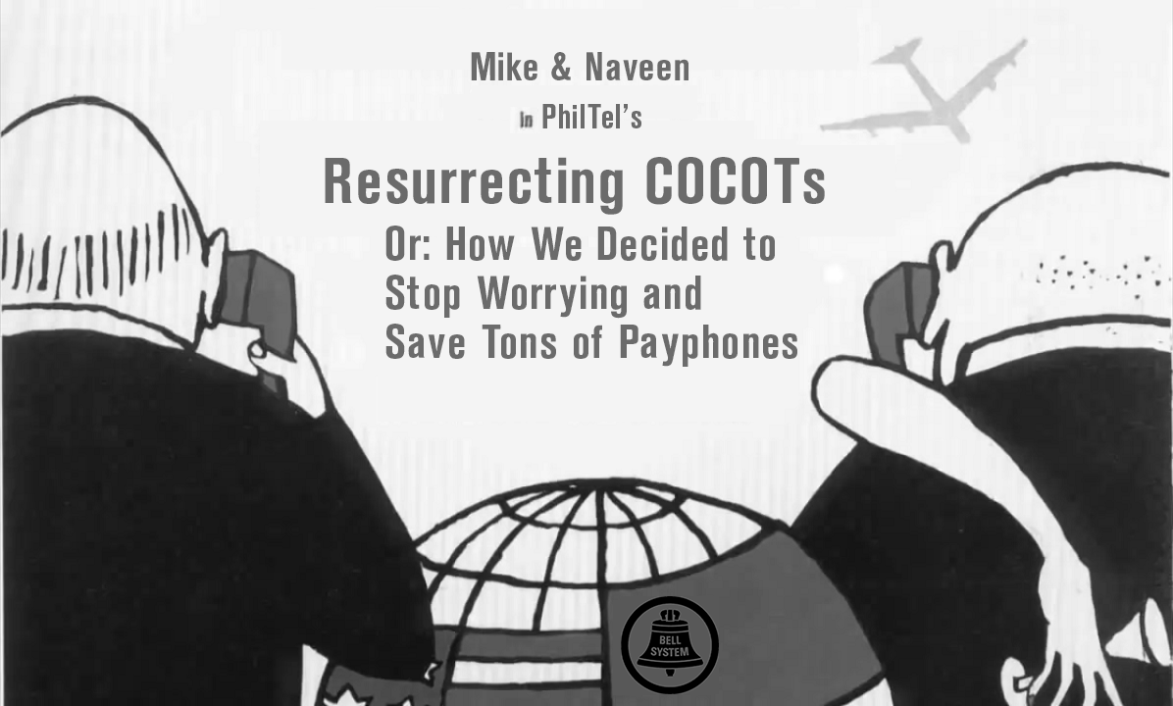

Slide 2
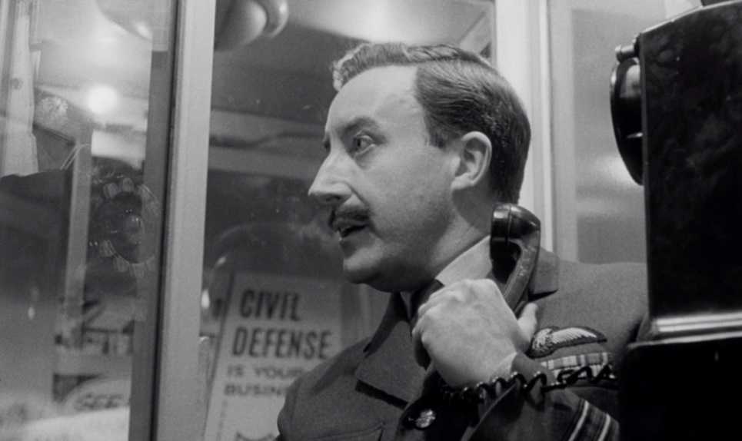
Agenda
Who are we and what is PhilTel?
What’s a payphone, what’s a COCOT?
NIPCAQ Updates (Mapping and scanning payphones)
The state of payphones in 2024
Let’s make a COCOT work
Can we create a free-to-use programming line?
Future Plans

Slide 3
Who are You?
Mike
Software engineer by trade, more excited when he can use a soldering iron
Has been doing weird VoIP stuff for 12 years
Loves phreak and hacker history
Isn’t afraid to run a half-dozen modems in his basement 24/7 (Dialup.world)
Naveen
Computer engineer with IT background
Phone phreak
“That guy” calling payphones with modems
Asterisk/DAHDI/C developer
Environmental activist

Slide 4
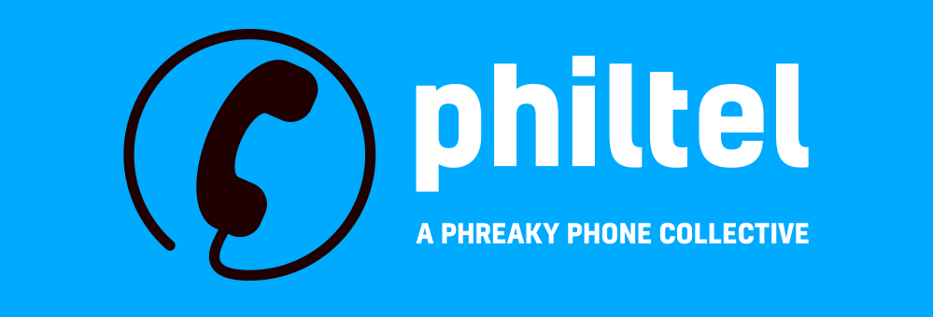
PhilTel
PhilTel is inspired by Futel, based out of Portland, Oregon
Bring payphones back but make them free-to-use this time (yes, we know it is a misnomer) because payphones are cool
Also focus on payphone preservation, archelogy, history, exhibition
Use as much discarded and second-hand stuff as we can, build with COTS hardware and open-source software -- nothing goes to waste!

Slide 5
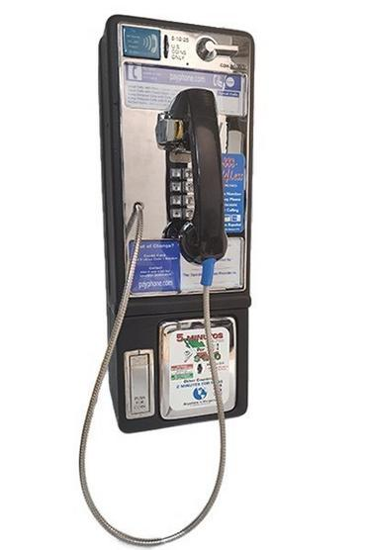
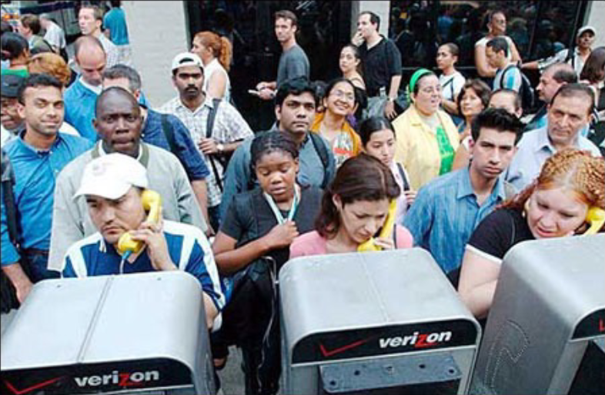
What is a Payphone?

Slide 6
What is a COCOT?
Customer-Owned Coin-Operated Telephone
Typically not owned by a telephone company but instead third-parties or individuals!
Starting in the ‘80s, anyone could run their own payphones and collect the tolls for themselves
COCOTs use “Smart boards” that rate calls at the phone itself instead of centrally at the telephone company via a coin line
If you use a payphone in the wild these days, it is almost certainly a COCOT

Slide 7
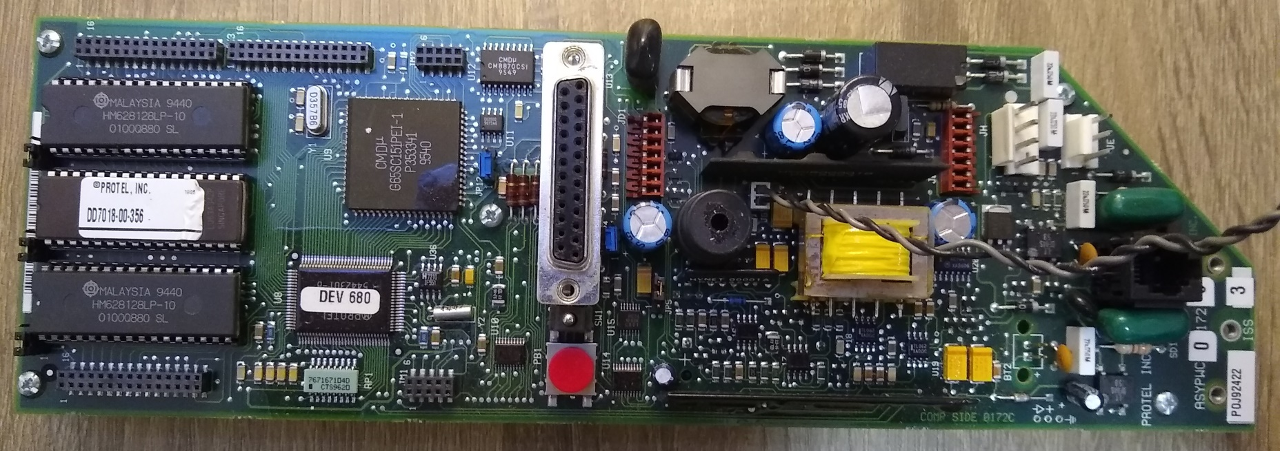
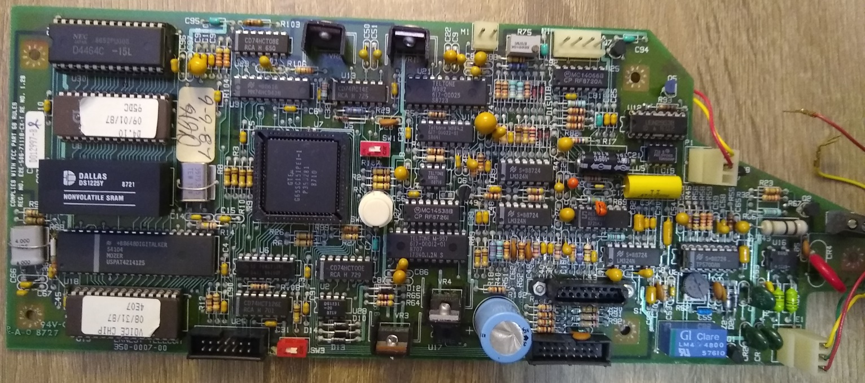
What is a COCOT?

Slide 8
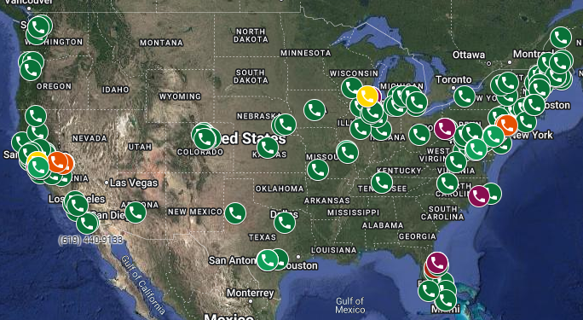
Where Can You Find A Payphone?
https://phreaknet.org/payphones/

Slide 9
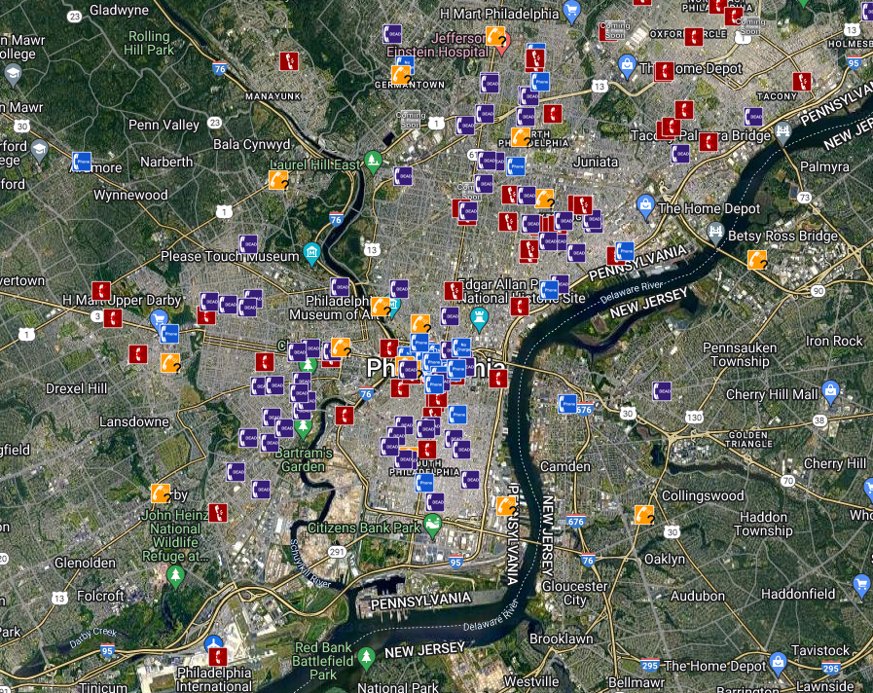
Philly Payphones

Slide 10
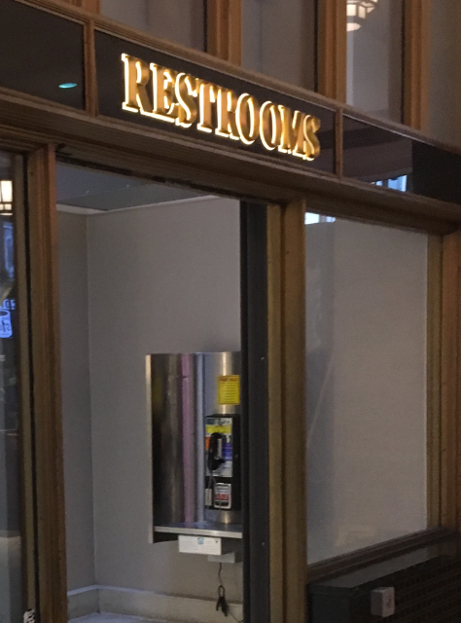
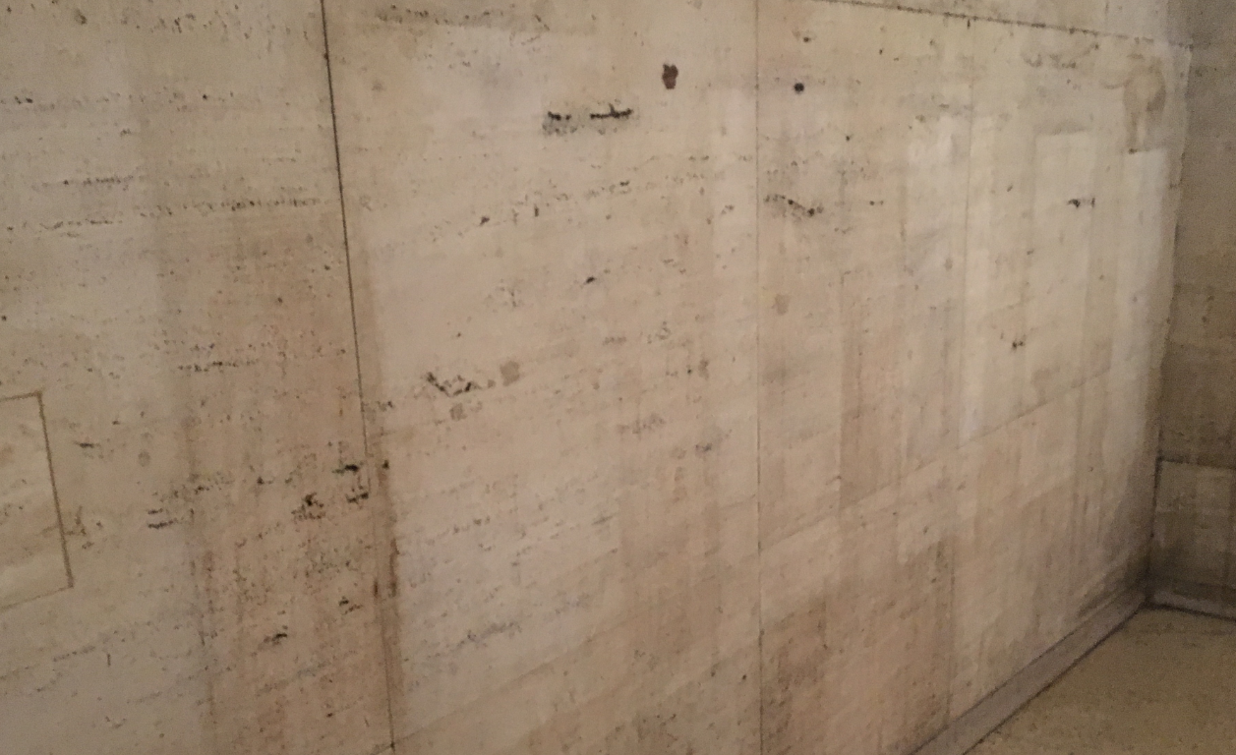
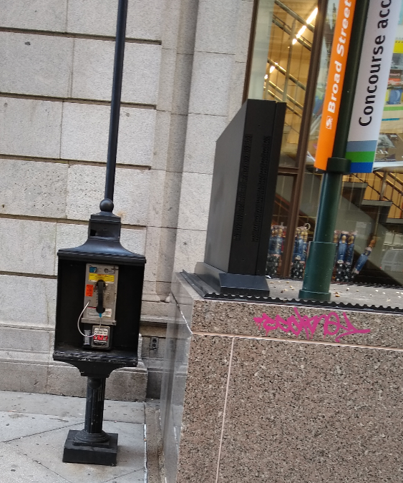
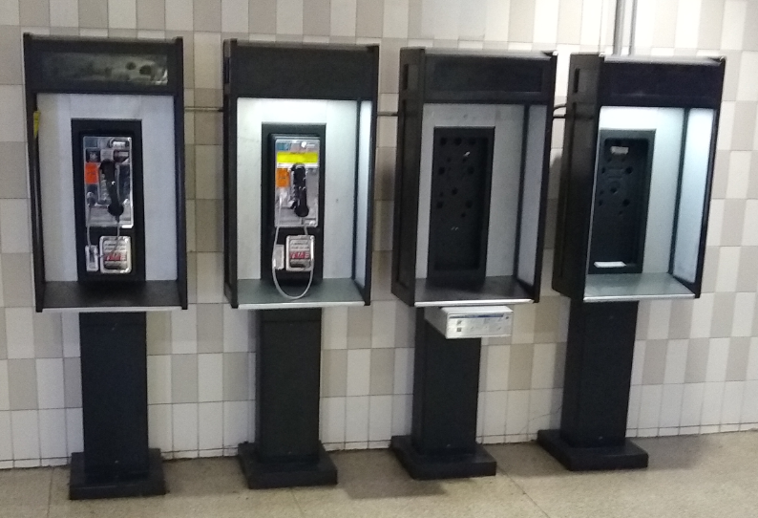
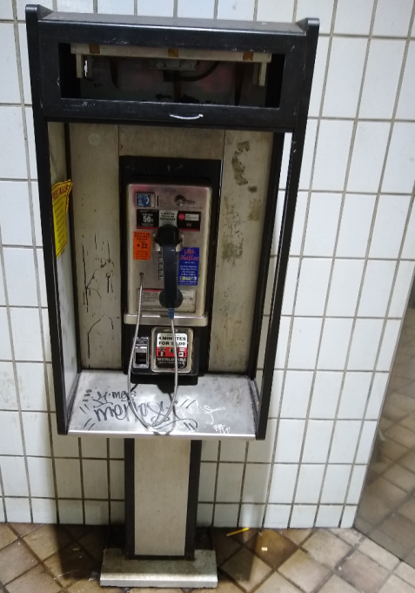
Local Payphones

Slide 11
What Happens If You Call A Payphone?
Historically… what you’d expect
No charge for answering incoming calls
Bell System had policies to prevent fraud
COCOTs typically answer with a 300/1200 baud modem
Allows for remote management
Useful for reporting…

Slide 12
Protel Printouts
TC!*2152229996*72765*DD8822*4868*025*2210301004552*67805*
Number
(215)
222-9996
Amount in
Coin Box
$727.65
-$678.05
= $49.60
Model No.
% Full
= 25%
Balance When Last Emptied
$678.05
Checksum
Only changes when emptied…
but not every time
Local Timestamp
2022
October 30
00:45 local time
(12:45 am EDT)

Slide 13
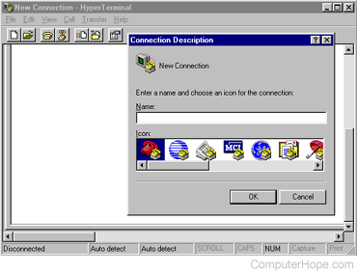

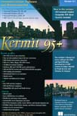
Automating It…
Usage summaries posted monthly in the NIPCAQ
https://phreakscan.com

Slide 14
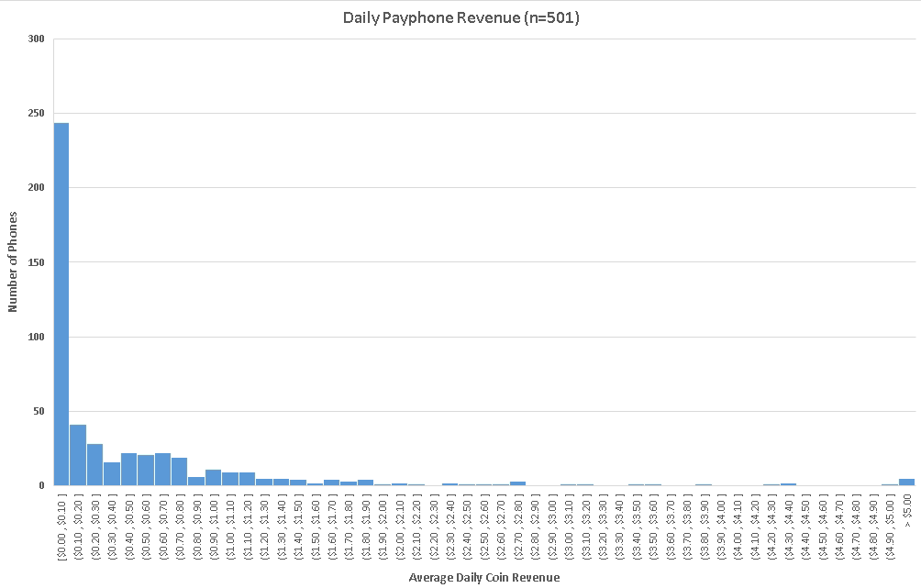
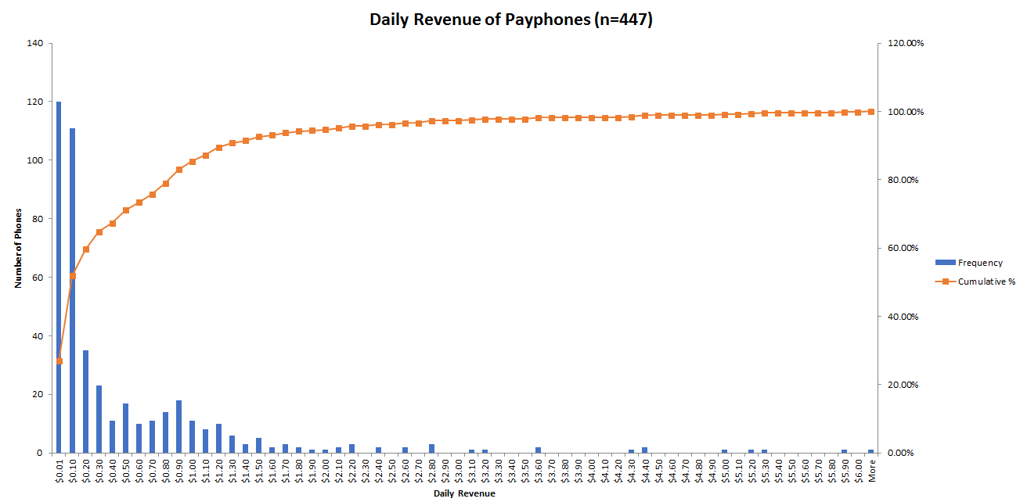
Payphone Revenue

Slide 15
Suburban Station
Location | FW | Avg | Total | To Date | Cur Bal | Last Query | LastChg | HH:MM Ago | Total Queries | Empties
Suburban Station NE | DD8822 | $0.46 | $729.10 | $775.25 | $25.85 | 2024-02-19 00:47 | $10.05 | 535:31 | 86 | 11
Suburban Station NW | DD8822 | $0.62 | $1126.65 | $1507.75 | $16.00 | 2024-10-05 07:44 | $15.50 | 141:45 | 126 | 18
Suburban Station SE #1 | DD8822 | $0.73 | $1332.65 | $2073.10 | $35.85 | 2024-10-05 08:27 | $5.50 | 168:01 | 132 | 28
Suburban Station SE #2 | DD8432 | $1.83 | $3326.45 | $4126.30 | $53.90 | 2024-10-05 07:55 | $10.05 | 168:00 | 126 | 18

Slide 16
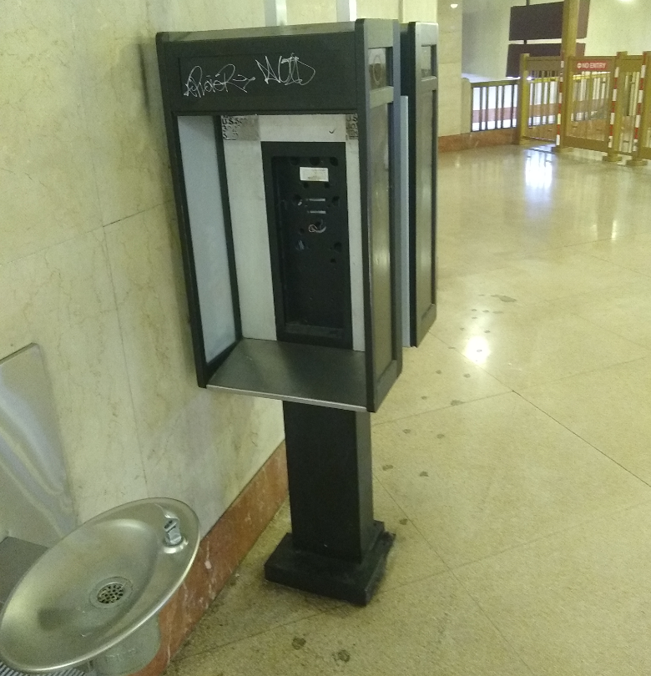
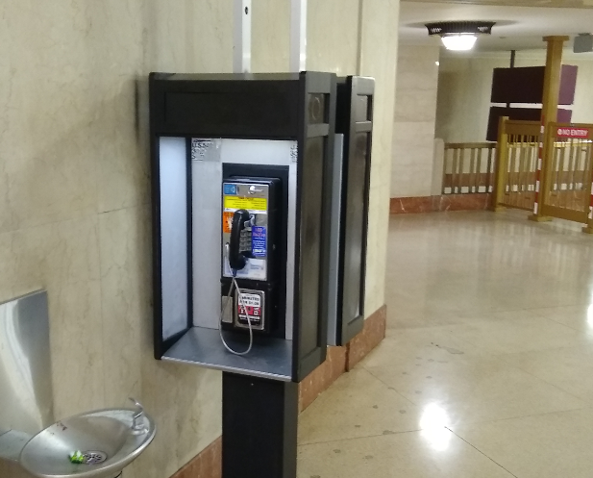
Suburban Station… then and now

Slide 17
ANACs
Identify the calling line
(800) 444-4444 – MCI
(800) 437-7950 – MCI
(844) 700-0431 – Payphone Reporting Line
Email payphones@phreaknet.org with the number and location

Slide 18
What does this mean for hobbyists?
Many payphones on the used market these days are COCOTs
COCOTs are somewhat undesirable to collectors because they are difficult to set up
Some COCOTs can be hand-programmed via the keypad but others require the phone to be interfaced with a PC running proprietary software
There are many COCOT manufacturers, but the “big four” are Protel, ElcoTel, Intellicall, and Ernest, with Protel arguably being the most common/popular

Slide 19
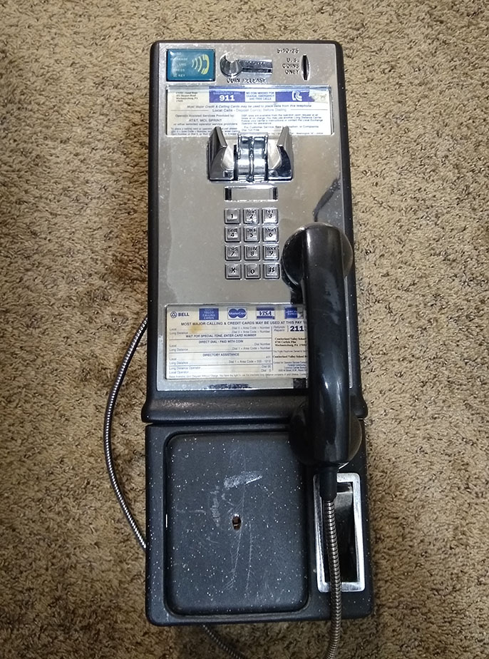
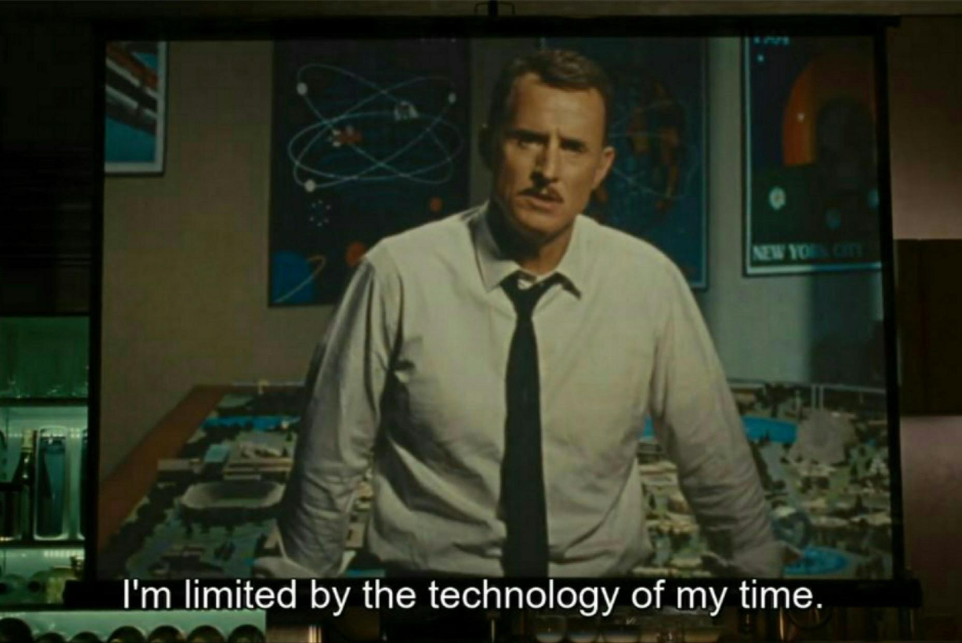
My Protel payphone, let’s program it!
Purchased when I was a teenager
Removed the Protel board to replace with a coinless board, but the original intention was to always use the Protel

Slide 20
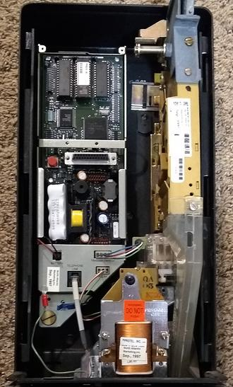
Protel Considerations
Uses NiCd battery for board power and 1/2AA Lithium battery for saving programming
Has socketed ROM (nice)
Connectors for keypad/handset, relay, coin scanner, telephone line
Programming Urban Legends:
Need a proprietary modem to program some models (what!?)
Need copper lines, no VoIP
Cannot run programming software in a VM, need bare metal

Slide 21
ExpressNet (Xnet)
‘90s DOS software to program Protel payphones remotely
Version 1.55 was cracked ages ago when someone found out a freely-downloadable upgrade disk image could become an installer
We’re going to use Windows 98 SE
It’s familiar
Windows 98 will be useful for other payphone software
We need an Options Record, Costing Record, and Site Record
Thanks to Dan C, John Porter, Peter (telesfor.org/payphones/), and El Jefe, wherever you are

Slide 22
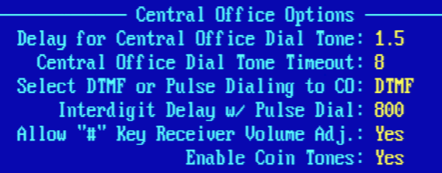
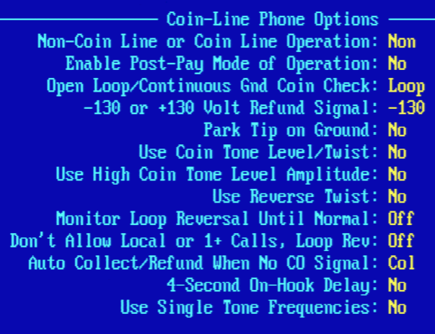
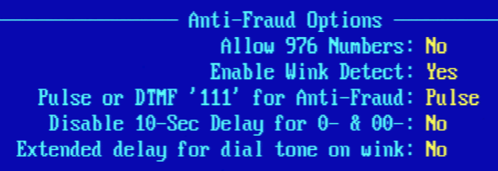
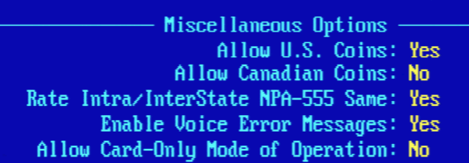
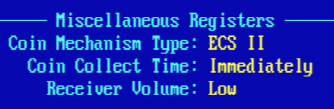
XNet Programming – Options Record

Slide 23
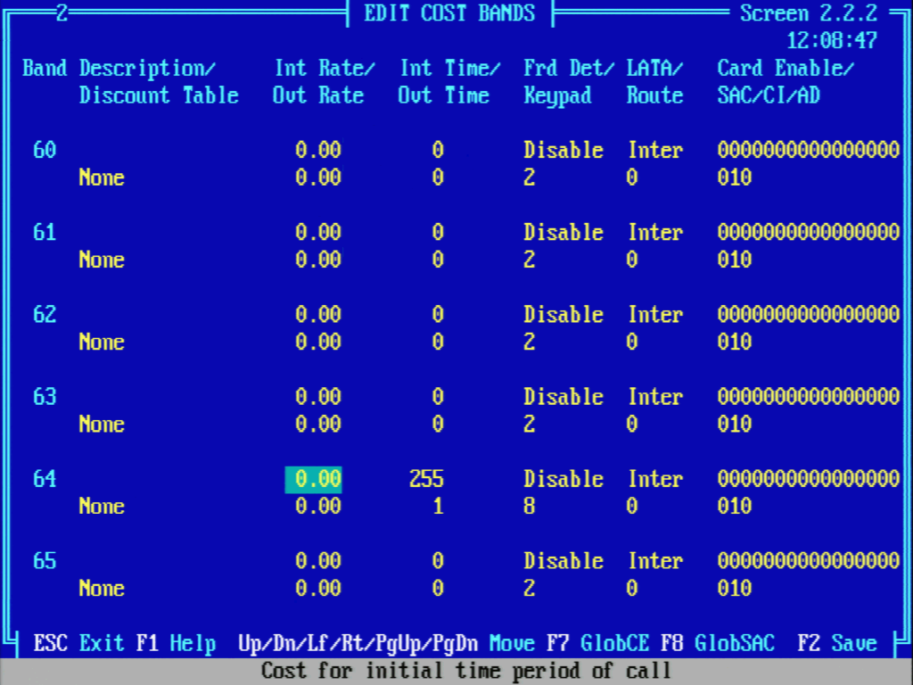
XNet Programming – Costing Record

Slide 24
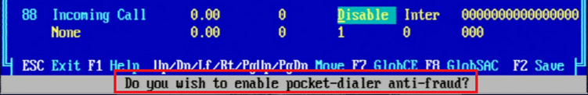

XNet Programming – Costing Record

Slide 25
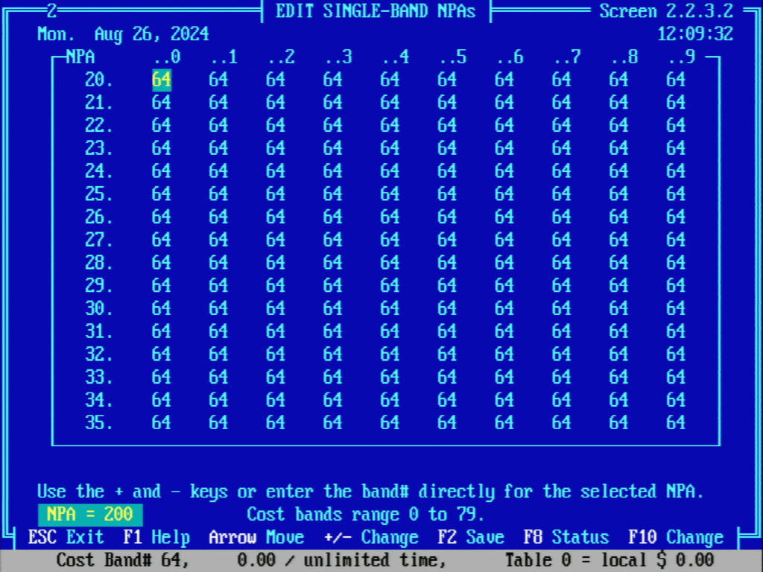
XNet Programming – Costing Record (Contd)

Slide 26
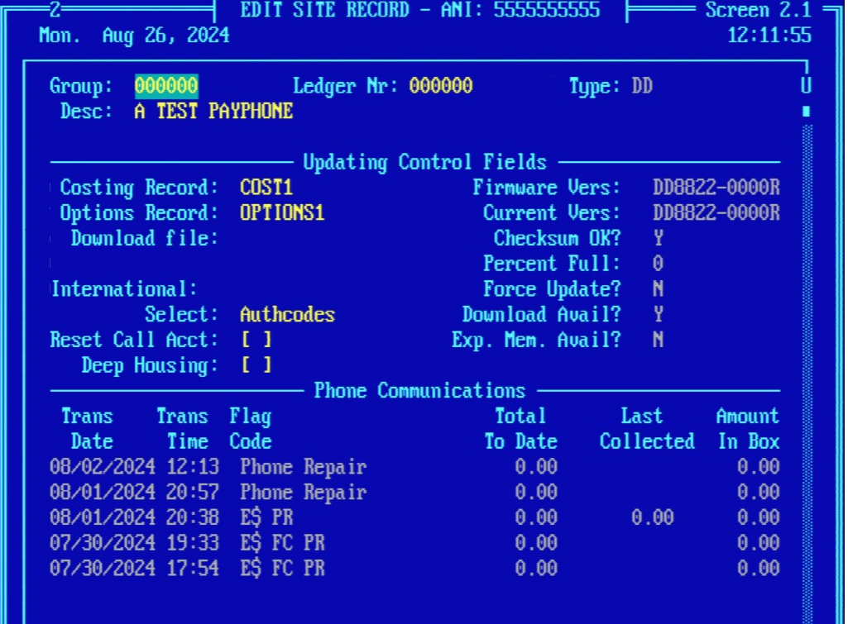
XNet Programming – Site Record

Slide 27
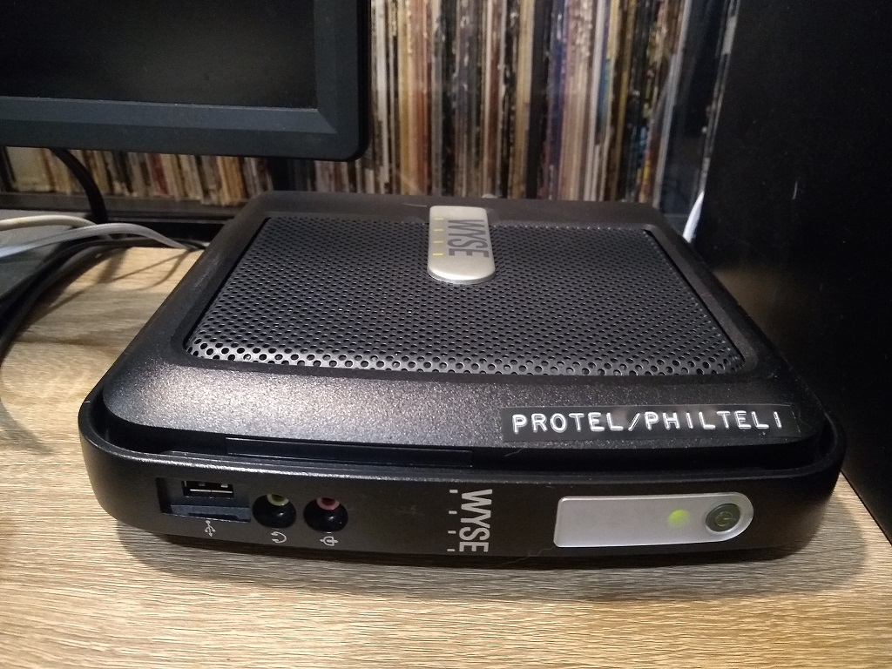
Where to run XNet? Let’s use a thin client!
Virtualization can work, but not reliably (we have more to test!)
We want bare metal, but vintage hardware might not like running 24/7
Wyse V90LE!
Low power, passive cooling, no moving parts (DOM)
VIA C7 Eden CPU, native x86
Real Serial port!
Supports USB

Slide 28
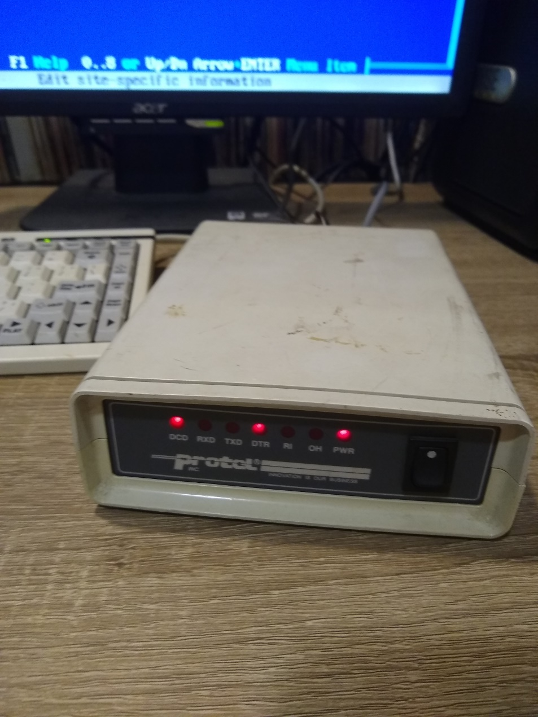
The UPMS-1200 Modem
Do we need a proprietary modem?
Naveen called Protel, they said “No”
Protel 7000 boards need a UPMS for 1200 baud programming because they use PSK modulation instead of FSK modulation, but work fine at 300 baud otherwise
Work has been done recently to test other modems with XNet with varying results (thanks Peter!) but I cannot get them to work myself
Your mileage may vary

Slide 29
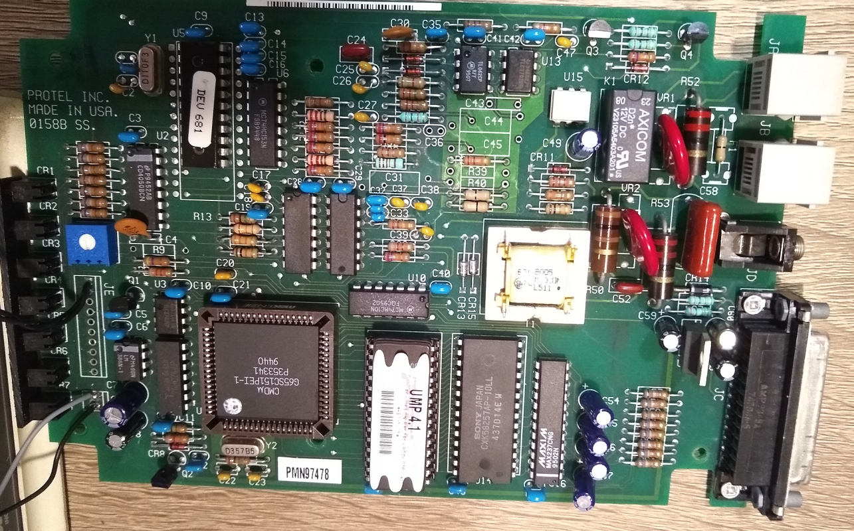
The UPMS-1200 Modem (Continued)
Was able to get one on eBay (eventually 2)
Was DOA ☹
Replaced capacitors and relay, now it works great!
Also added a speaker on/off switch, couldn’t mute in software

Slide 30
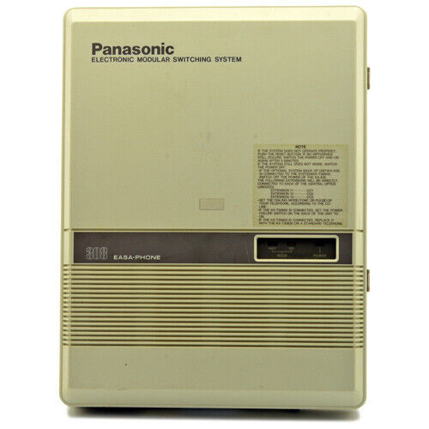
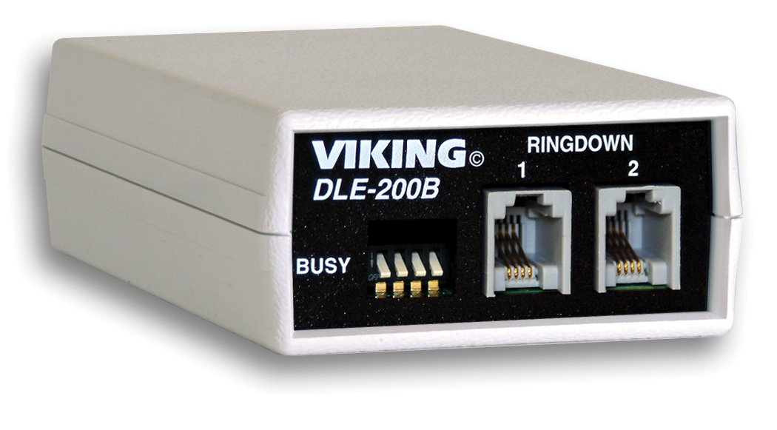
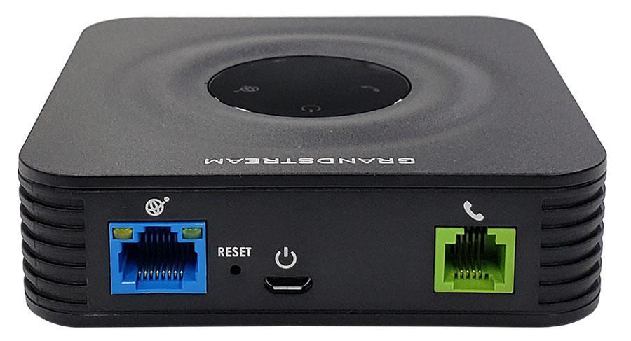
How to connect the modem and the phone?
Analog PBXs and phone line simulators should work just fine, but they’re not great for public connecting
Analog Telephone Adapters won’t work (at least on both sides)
This isn’t a problem for dial-up Internet, I can get reliable V.34 connection with ATAs for dialup.world
What else is there?

Slide 31
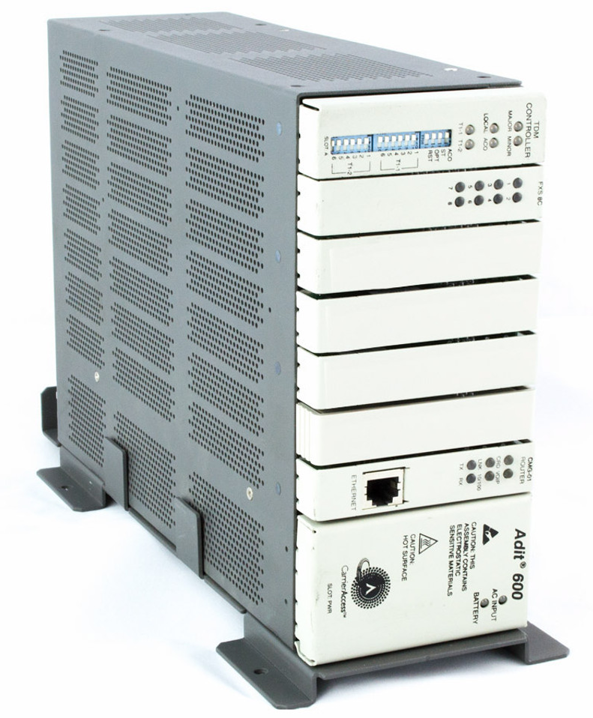
Channel Bank – Adit 600
A device that muxes/demuxes a group of communications channels
Many are modular, allowing different cards for different uses
In this case, analog telephone lines are combined into a DS1 circuit going over one cable (trunk line)
Provides us a serial port for programming, T1 port, and RJ-21 (25-pair) port for phone lines
(Analog card should also work)

Slide 32
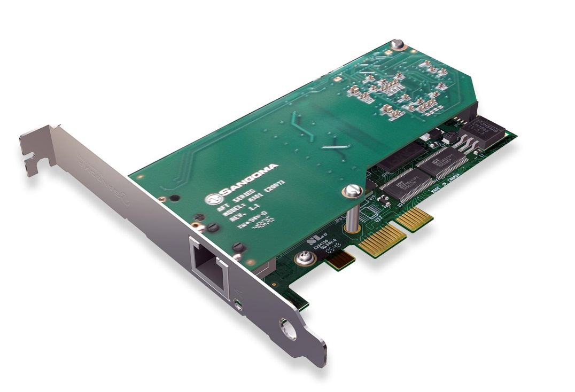
T1/E1 Card – Sangoma A101(ish)
Adds a T1/E1 interface to your computer
Integrates with Asterisk using Digium Asterisk Hardware Device Interface (DAHDI)
Requires compiling Asterisk with DAHDI support
I have a Sangoma card, which meant using “Wanpipe” software that sits between DAHDI and the card to simulate a Digium card
If you’re doing this, just find a Digium card

Slide 33
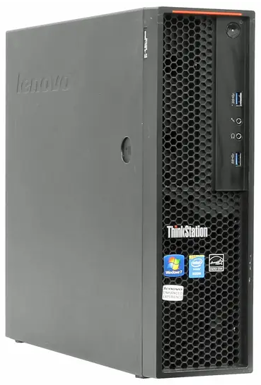
The PBX – Thinkstation E32 with Asterisk
Cheap SFF PC
Booting Debian 12 11
Many issues compiling WanPipe with Debian 12, Sangoma support said use Debian 11 (sure)
Still had issues with Debian 11, had issues with Osmocom’s alternate installation
Found an issue with build script, submitted my fix to Sangoma, eventually it was patched
Use PhreakScript to install Asterisk, DAHDI, and Wanpipe automatically

Slide 34
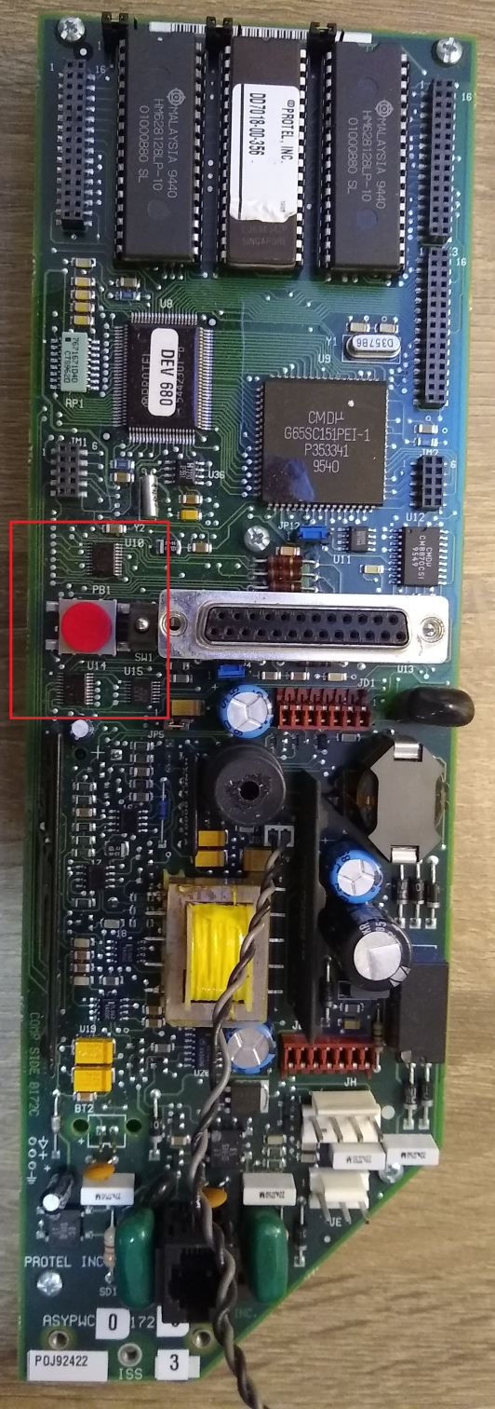
How do we program?
Hold down the program button and take the phone off-hook, hear a single beep, then release the program button
On the keypad, dial 005555555555*, you should then hear a single beep.
Next, dial 25<MODEM#>*, you should then hear a single beep.
Finally, dial *#3

Slide 35
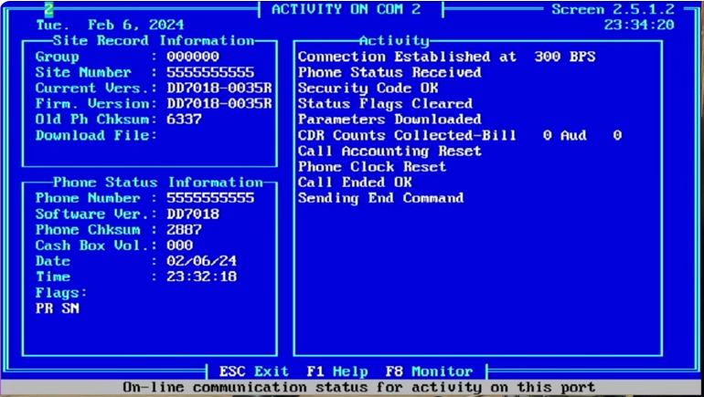
Success!

Slide 36

Outcome
We have a free-to-use programming line that will rate all calls free
How can we access it?
Via PSTN, 225-2PROTEL or 225-277-6835
Via PhreakNet, 263-0500
Via SIP, protel:protel@programming.philtel.org:16556
We take custom programming requests
via hello@philtel.org
Payphones can be field reprogrammed
With permission of course

Slide 37
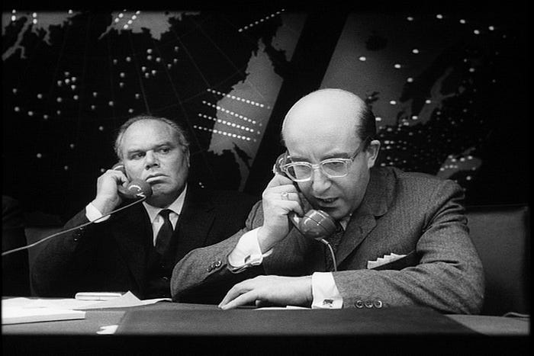
Next Steps
Custom programming automation so people can request specific programming and then have it available shortly
Reverse engineering to eliminate ExpressNet entirely
Possible integration into Asterisk softmodem
Programming lines for ElcoTel Phones and Nortel Millenniums
We already have hardware and software for this!
Full automation of COCOT scanning software

Slide 38

Questions?
Mike
mike@philtel.org
Famicoman (Libera IRC)
https://famicoman.com
https://github.com/Famicoman
Naveen
interlinked@philtel.org
InterLinked (Libera IRC)
https://interlinked.us
https://github.com/InterLinked1

